Slide 1
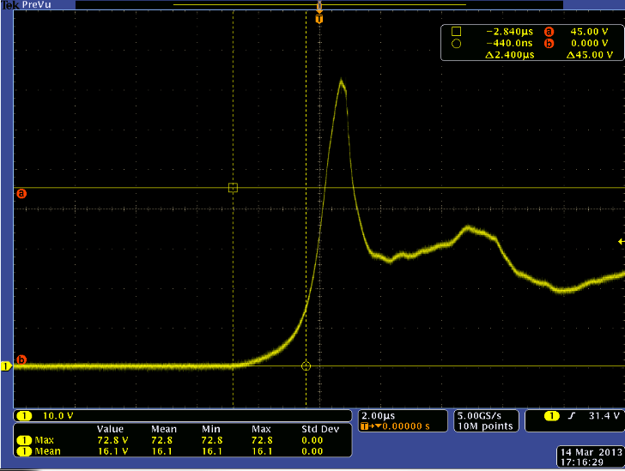
TVS Diode to prevent transient spikes at Vcc with BD9G101G Eval board
BD9G101G: VCC(max): 45V, 42V (operating)
Vcc = 35V, ceramic cap only, 72V transient spike (cursors show 45V max limit), NOT GOOD

Slide 2
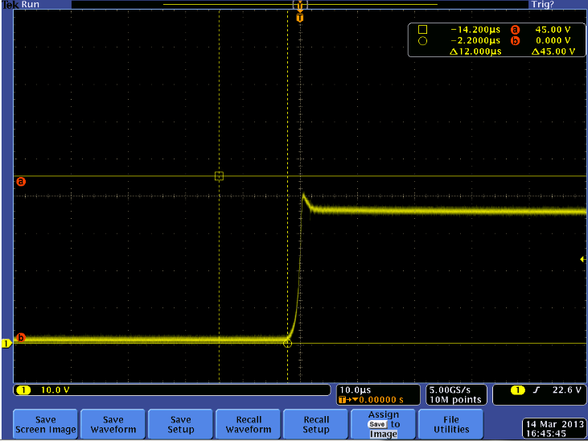
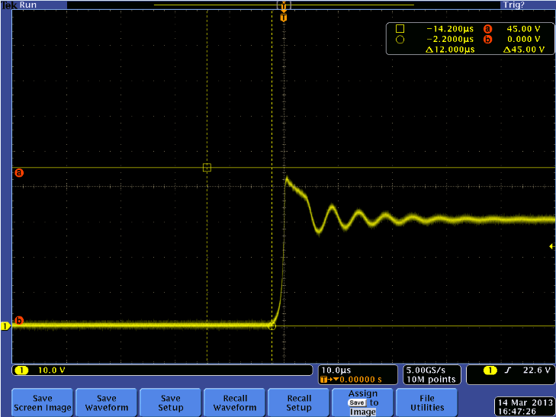
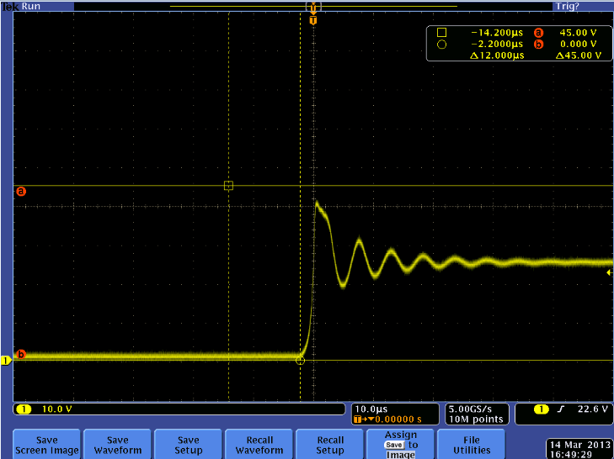
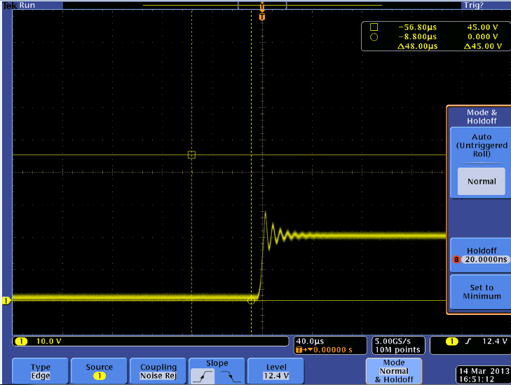
TVS Diode 30V 400W 5% Results:
A. Vcc=35V, 44Vpk clamp, GOOD
B. Vcc=30V, 40Vpk transient, GOOD
C. Vcc=25V, 40Vpk transient, GOOD
D. Vcc=20V, 28Vpk transient, GOOD

Slide 3
Data:
Vcc (V) | Transient Peak Voltage
 | 40V TVS Diode | IC Status | 30V TVS Diode | IC Status
20 | 40 | OK | 30 | OK
25 | 50 | OK | 40 | OK
30 | 55 | NG | 40 | OK
35 | n/a | NG | 44 | OK
40 | n/a | NG | 46 | OK
45 | n/a | NG | 50 | OK
Previously, the IC was destroyed with a 27-30V hot plug on Vcc. Goal is to protect eval board from destruction while increasing Vcc operating range.
Conclusion:
30V TVS diode should be used in parallel with the ceramic input cap to prevent 45V+ transient peaks at Vcc. A higher value diode can be used to increase the operating range, but this will increase the chances of the IC being destroyed at those higher voltages. Eval board limit in manual will be 35Vin. In the lab, up to 45Vin was used on the board with the diode and the board survived after (20 hot plug tests).

